Slide 1
COMPUTERIZED CHURCH DATABASE AND COMMUNICATION SYSTEM
Final Year Project Defense
(BLESS NARH AYERTEY) | (B202230831)
Supervisor: [DR. BENJAMIN KWOFIE]
(COMPUTER SCIENCE) | (11TH NOVEMBER, 2025)

Slide 2
Chapter One: Introduction
• Background of the Study
• Problem Statement
• Objectives of the Study (General & Specific)
• Significance of the Study
• Scope & Limitations

Slide 3
Chapter Two: Literature Review
• Overview of church management systems
• Related works and gaps identified
• Technologies commonly used
• Summary of findings

Slide 4
Chapter Three: System Analysis & Design
• Description of the existing system
• Weaknesses of the manual system
• Proposed system overview
• UML diagrams: Context, Sequence, ERD, Activity

Slide 5
System Features & Tools
• Major features of the proposed system
• Development tools: PHP, MySQL, HTML, CSS, XAMPP
• Development environment

Slide 6
Chapter Four: Implementation
• Mapping logical design onto physical design
• Modules implemented: UI, Database, Communication, Authentication
• Integration of modules

Slide 7
Testing & Results
A comprehensive testing plan was carried out to ensure the system’s reliability, functionality, and overall performance. The process began with unit testing, where individual modules and components were tested separately to verify that each function operated as expected. This was followed by integration testing, which focused on examining how different modules interacted with each other to ensure smooth data flow and compatibility. Subsequently, user acceptance testing (UAT) was conducted to evaluate the system’s performance from the end-user perspective, confirming that all requirements were met and the system was easy to use.
In addition, verification and validation testing were performed to ensure that the system not only met design specifications but also fulfilled the intended purpose effectively. Security testing was also carried out to identify and eliminate vulnerabilities, ensuring that data and user information remained protected. Finally, feedback from testers provided valuable insights, which were used to make further refinements and improvements to the system, resulting in a more stable and efficient final product.

Slide 8
Testers’ Recommendations & Responses
• During the course of this project, several key features were successfully developed and integrated to enhance the system’s performance and user experience. A search filter was added to enable users to easily locate specific records or data, improving accessibility and efficiency. The database backup feature was implemented to ensure data safety and reliability, allowing users to securely store and recover important information when needed. Additionally, a bulk SMS feature was integrated to facilitate instant communication with multiple users, increasing the system’s interactivity and convenience. These achievements collectively contributed to a more robust, user-friendly, and dependable system that meets the project’s overall objectives.

Slide 9
Chapter Five: Summary, Conclusion & Recommendations
• Summary of project achievements
• Conclusion: project objectives met
• Recommendations:
- Regular system updates
- Training for church staff
- Future integration with mobile apps/cloud

Slide 10
Chapter Five: Summary, Conclusion & Recommendations
This project successfully achieved its main objectives, which were to design, develop, and implement a functional system that addresses the identified problem. The system was able to perform all intended operations efficiently, providing accurate results and a user-friendly interface. Through testing and evaluation, the project demonstrated improved performance compared to existing methods. Additionally, the project enhanced my technical knowledge, problem-solving ability, and research skills. Overall, the implementation of this project has proven to be effective, reliable, and beneficial to its intended users, fulfilling the goals set at the beginning of the work.

Slide 11
System Demo (Screenshots)
• Login page
• Member registration form
• Reports
• Communication interface

Slide 12
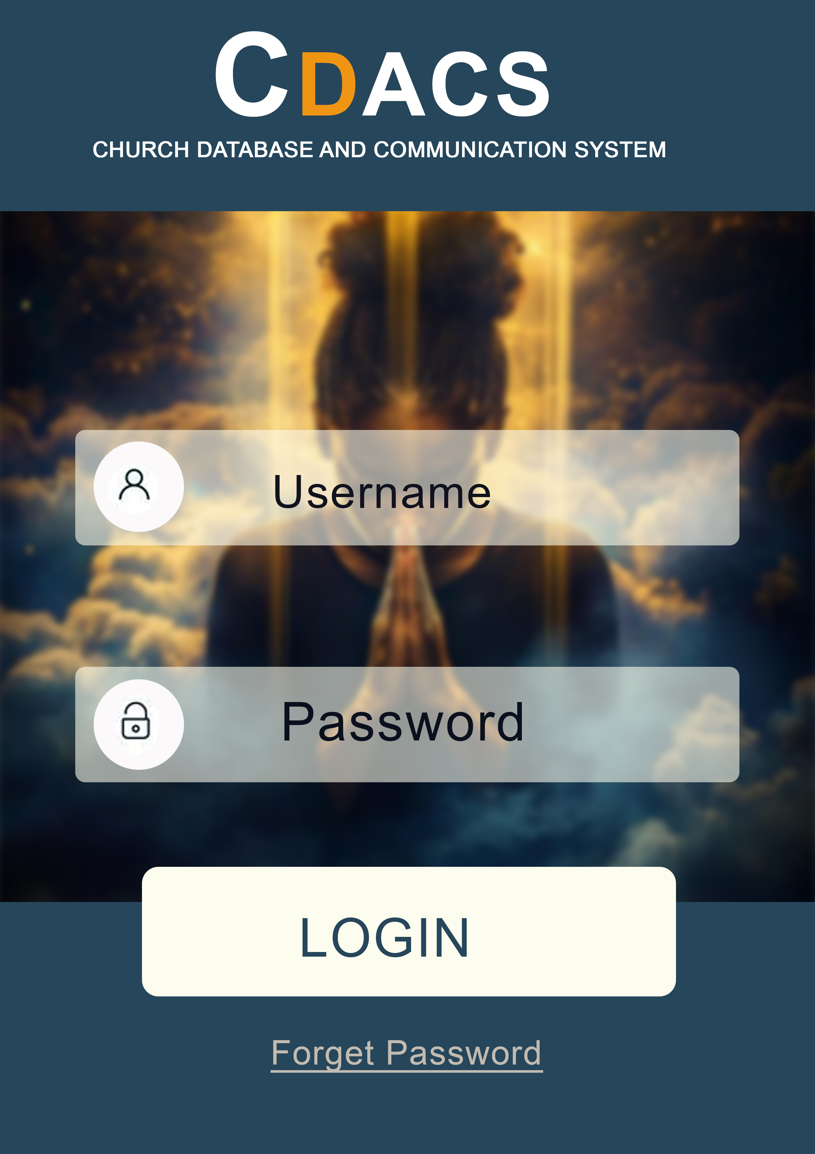
LOGIN

Slide 13

Member registration form

Slide 14

Communication interface

Slide 15
Reports

Slide 16
Acknowledgments
I would like to express my sincere appreciation to my Supervisor Dr. Benjamin Kwofie for his invaluable guidance, encouragement, and constructive feedback throughout the course of this work. His patience and insights have been instrumental in shaping this project to its successful completion. My heartfelt gratitude also goes to the Department for providing the necessary facilities, resources, and a supportive academic environment that made this research possible. Special thanks are extended to the Testers who dedicated their time and effort to thoroughly evaluate and provide helpful suggestions for improving the system. Their contribution played a vital role in refining the final output.
Finally, I wish to express my appreciation to everyone who directly or indirectly supported me in completing this work. Thank you all for your attention and continued support.

